Slide 1
HEAP

Slide 2
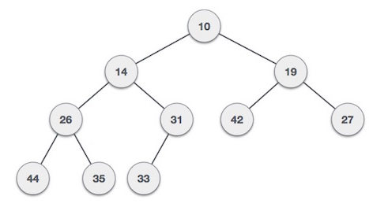
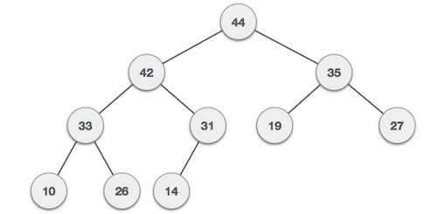
Heap
Heap is a special case of balanced binary tree data structure where root-node key is compared with its children and arranged accordingly
If α has child node β then −
key(α) ≥ key(β) or key(α) <= key(β)
Heap is a binary tree that sores priorities pair at node

Slide 3
Heap Property
Heap has two property :
Structural property :
All levels are full except last levels . Last level is left filled.
A complete or nearly complete binary tree.
Heap Property :
Priority of a node is as large or small as that of its parent
Can be represented in an array and no pointers are necessary.

Slide 4
Heap Property
Based on this criteria a heap can be of two types:
Min Heap
where the value of root node is less than or equal to either of its children.
Max Heap
where the value of root node is greater than or equal to either of its children. Max heap is often called as heap

Slide 5
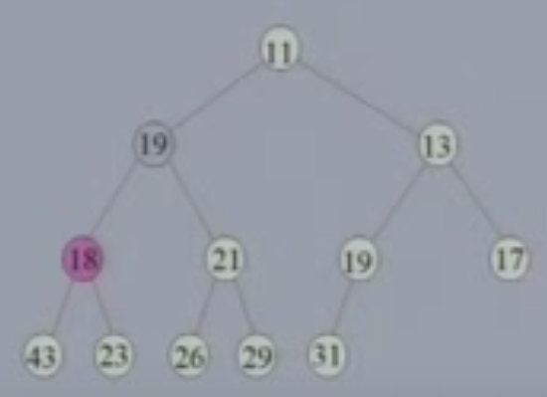
Example of Non-Heaps
Heap Property Violated :

Slide 6
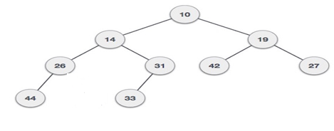
Example of Non-Heaps
Structural Property Violated :

Slide 7
Height of Heaps
Recall from complete binary tree :
if height of the tree h, then number of nodes n =2^{h+1} -1
hence n = 2^{levels} -1
=> n+1= 2^{levels} = 2^{h+1}
=> log₂ (n+1) = h+1
=> h = log₂ (n+1) -1
=> h = └log₂ (n+1)-1 ┘

Slide 8
Maintenance Operations
Two basic maintenance operations are performed on heap.
Insertion
Deletion
To implement this basic operation we need two algorithm :
Reheap Up
Reheap down

Slide 9
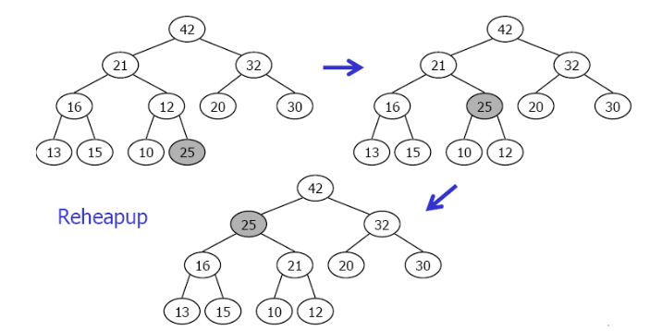
Reheap Up
Suppose we have a nearly complete tree with N elements whose N-1 element satisfy the heap property but the last element does not
The reheap Up operation repairs the structure so that it is a heap by floating the last element up the tree until that element is in its correct location in the tree.

Slide 10
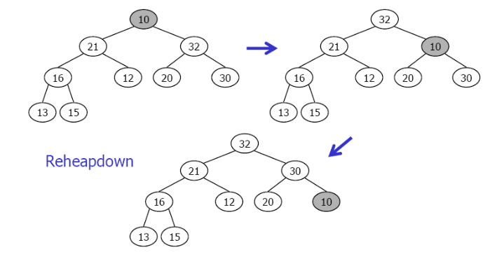
Reheap Down
Repairs a "broken" heap by pushing the root of the subtree down until it is in its correct location.

Slide 11
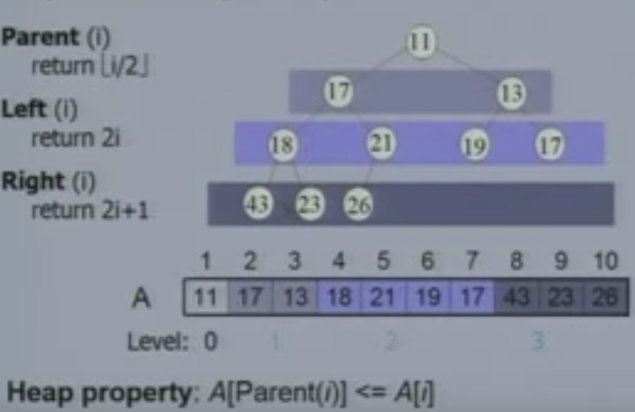
Implementing Heaps

Slide 12
Implementing Heaps (cont…)
The implicit tree link : children of node i are 2i and 2i+1
Why is this important?
In a binary representation a multiplication and division by 2 is a left/right shifts
Adding 1 can be done by adding the lowest bit

Slide 13
Reheap Up Algorithm
Algorithm ReheapUp (position )
If ( position > 0){ // the parent of position exists.
parent = (position-1 ) / 2;
if (data[ position] > data[parent])
{ swap( position , parent )} // swap data at position with data at parent.
ReheapUp (parent)
return;}
End ReheapUp

Slide 14
Reheap Down Algorithm
Algorithm Reheapdown (position , lastposition)
leftChild = position*2+1
rightChild = position*2 + 2
if ( rightChild <= lastPosition || leftchild <= lastposition )
if( data[ rightChild ] < data[ leftChild]) // > for max heap
child = rightChild
else
child = leftChild
if ( data[child] < data[position]) //> for max heap
swap(child, position)
ReheapDown (child, lastPosition )
end if;
end if;
end if;
End ReheapDown

Slide 15
Build heap
Suppose , Given a filled array , to build he heap we need to rearrange the data so that each node in the heap is greater than or less than its children.
We consider two parts of array, one is heap and other part contains element to be inserted into the array
At the beginning, first node of array is in heap and rest of the array are data to be inserted.
Then take the next element and check if it satisfies the heap property i.e parent root has value greater or smaller than the children. If heap property violate then call reheap up operation to solve the problem.
This process sometimes referred to as heapify

Slide 16
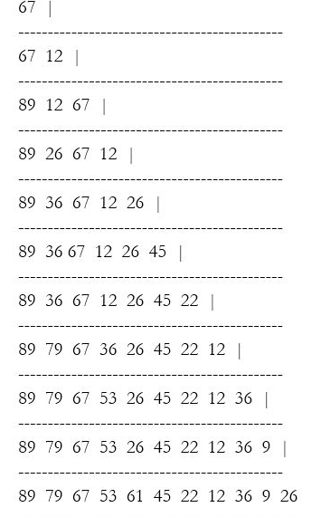
Build max heap example
67
12
89
26
36
12
45

Slide 17
Build heap
Algorithm BuildHeap (listOfData)
count = 0
loop(count < listOfData.Size())
data[count] = listOfData[count]
ReheapUp( count );
count = count + 1
end loop;
End BuildHeap

Slide 18
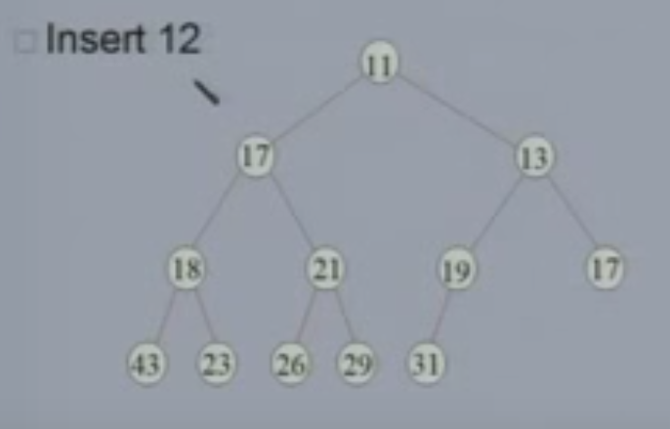
Insertion into Heaps

Slide 19
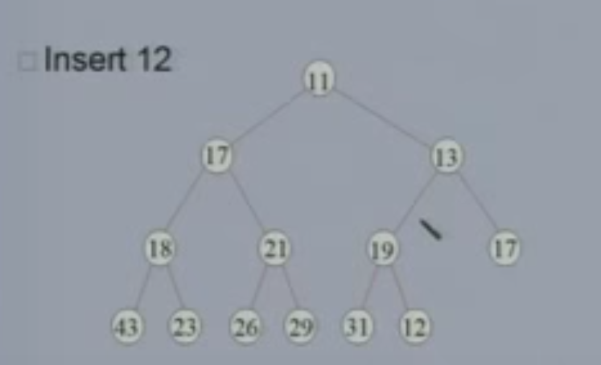
Insertion into Heaps

Slide 20
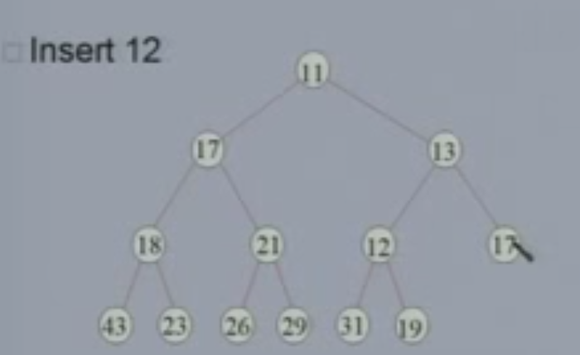
Insertion into Heaps

Slide 21
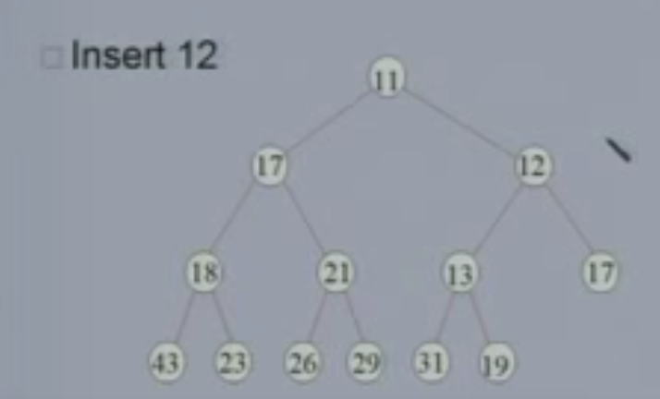
Insertion into Heaps

Slide 22
Insertion into Heaps
Recursive
InsertHeap(DataIn) if(heap is full) return overflow else data[count] = DataIn ; ReheapUp( count) count = count+ 1 end if; End InsertHeap

Slide 23
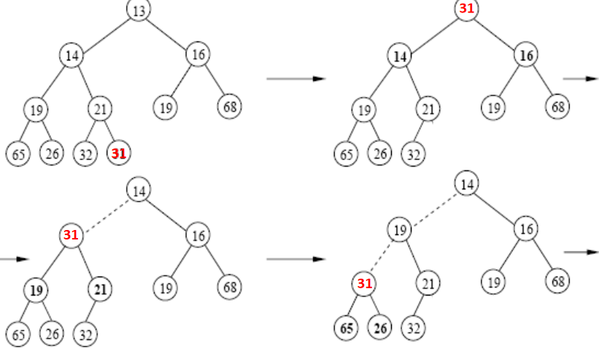
Delete min Heap
Delete the top element
The element in the last position is put to the position of the root, and Reheap Down is called for that position

Slide 24
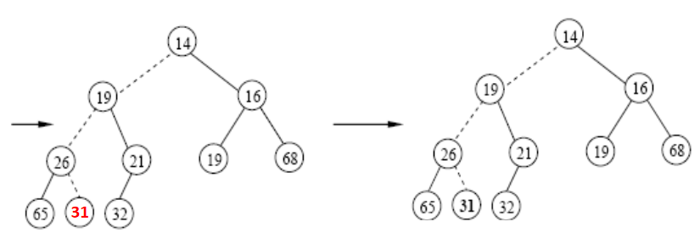
Delete min Heap

Slide 25
Delete min Heap
if (heap is empty)
return underflow
else
Data[0] = Data[count ]
count = count - 1
ReheapDown(0, count )
End if;

